Slide 1

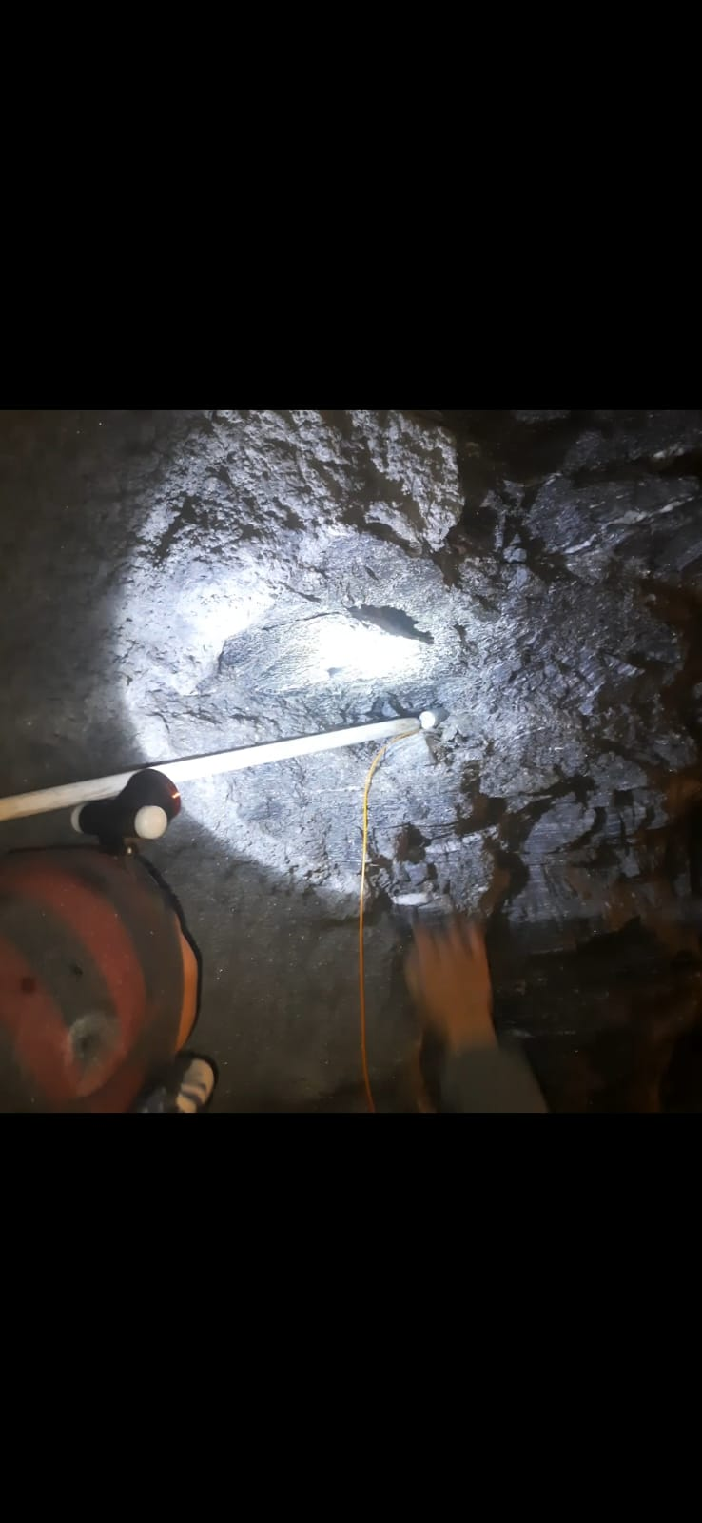
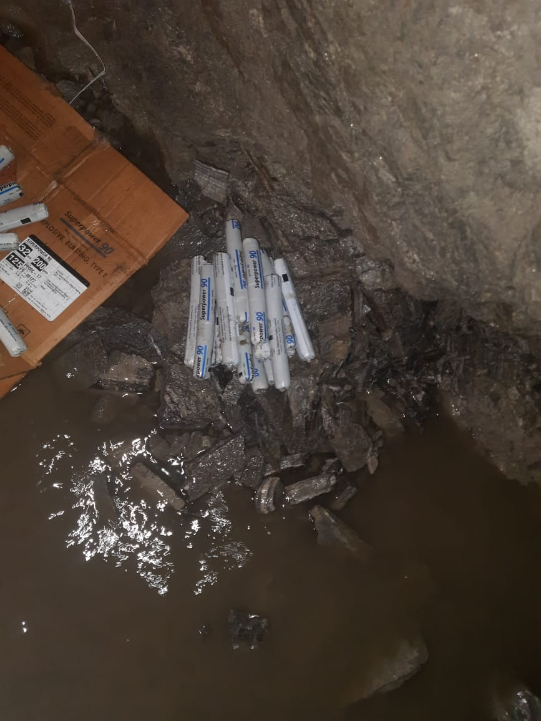
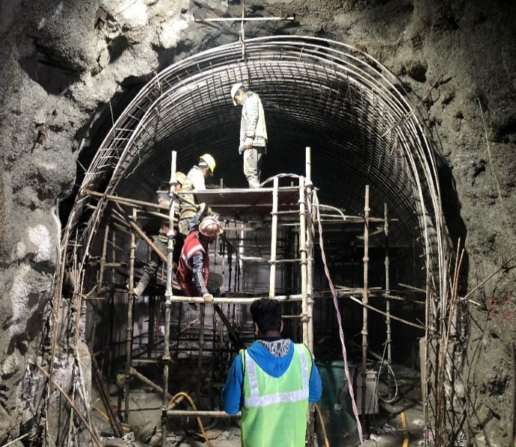
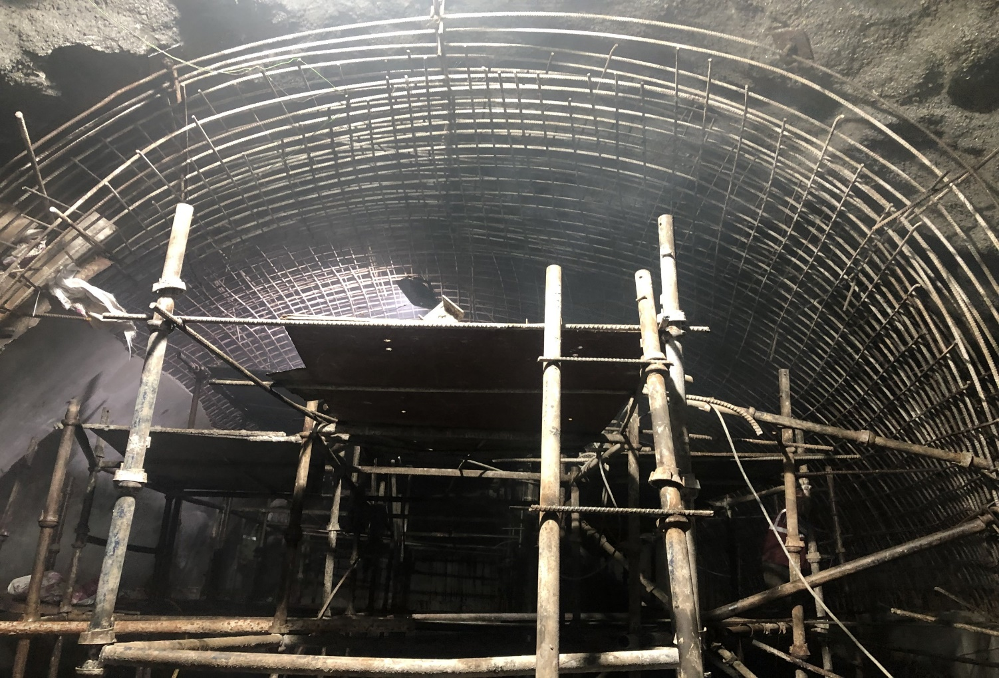
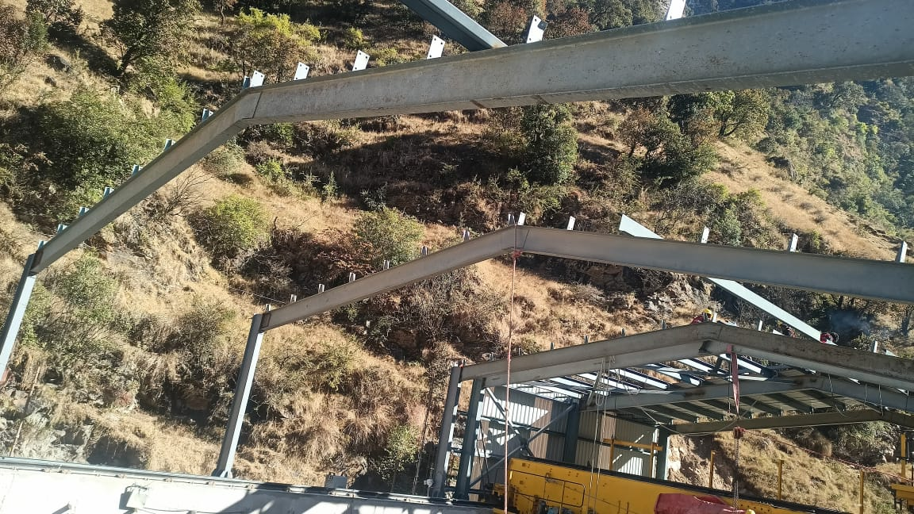
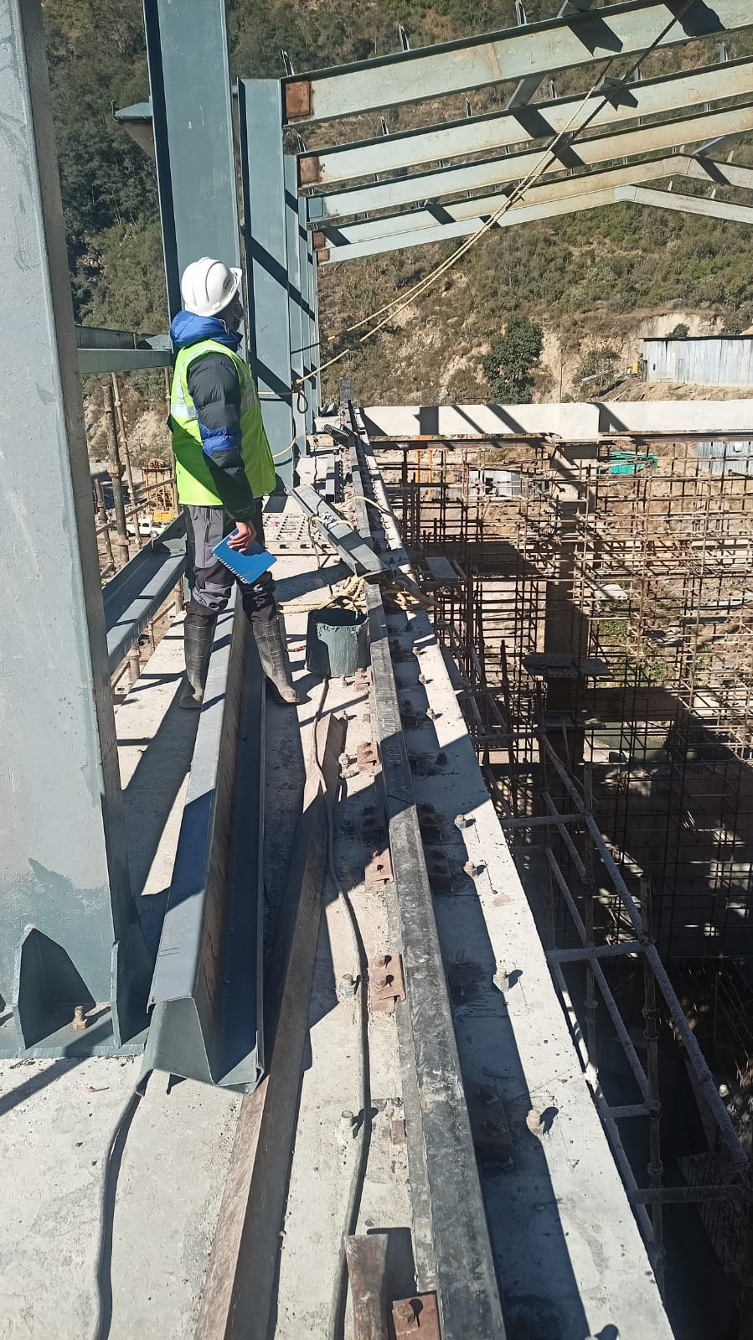
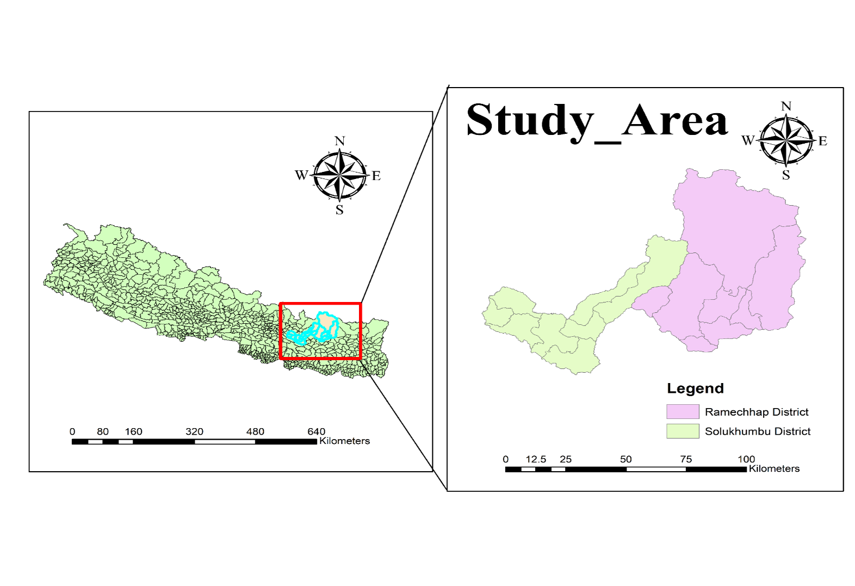
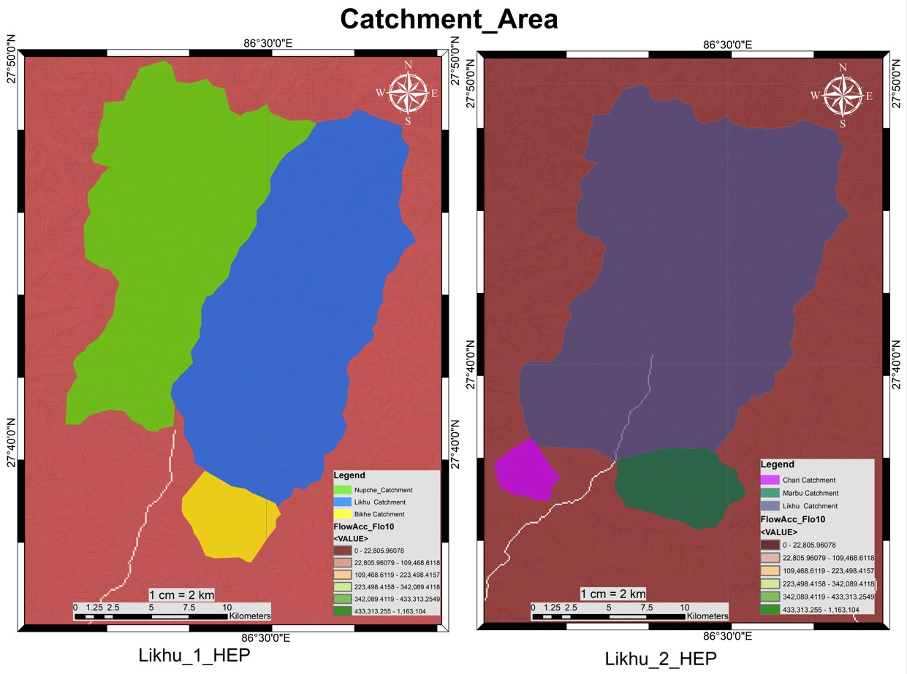
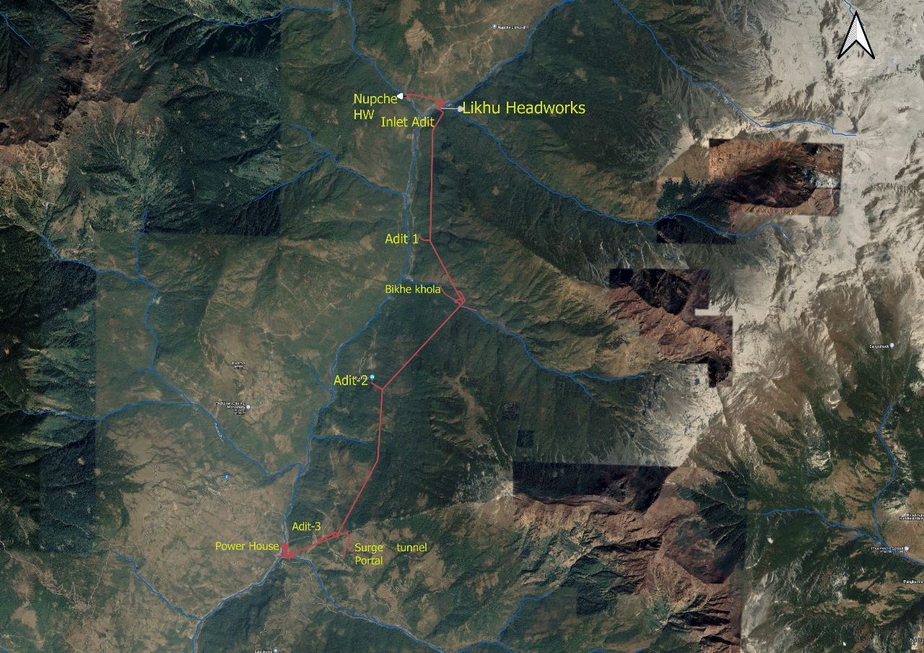
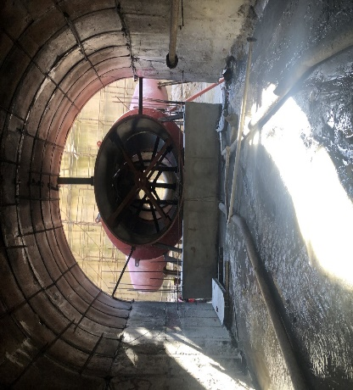
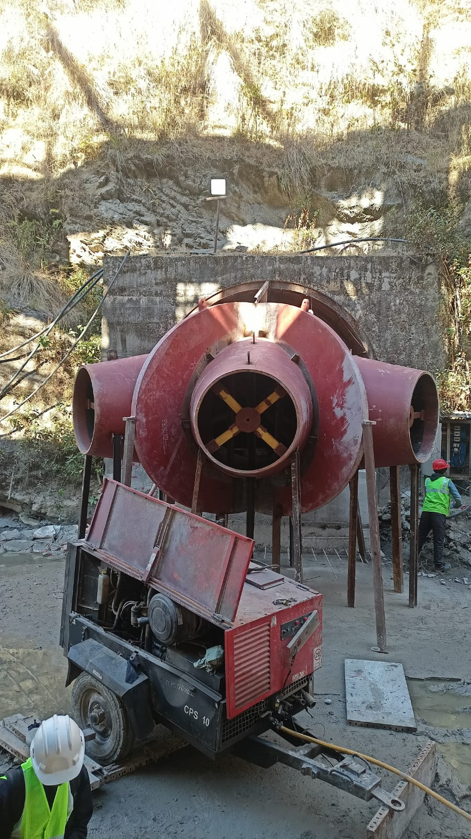
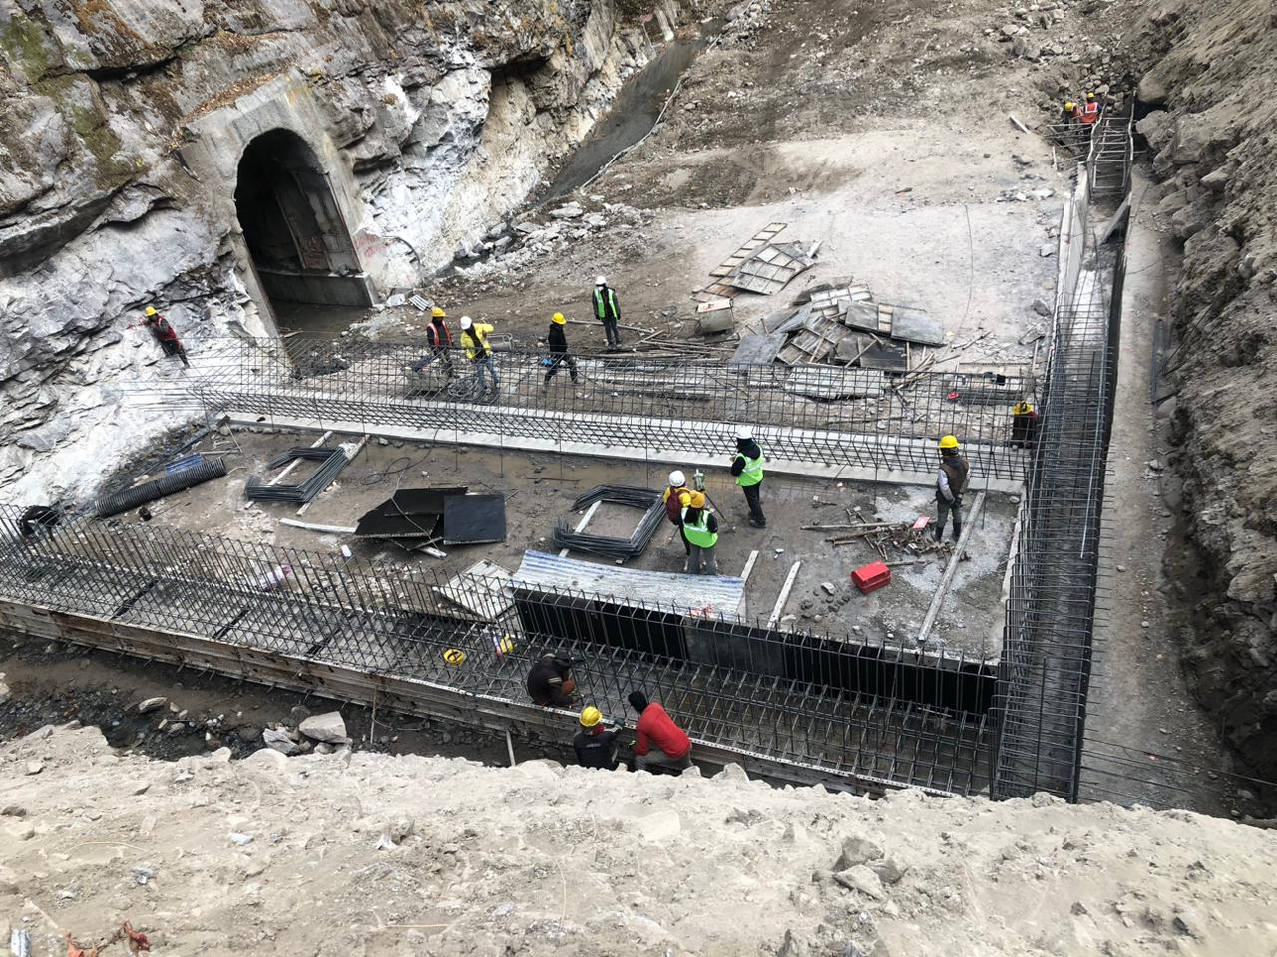
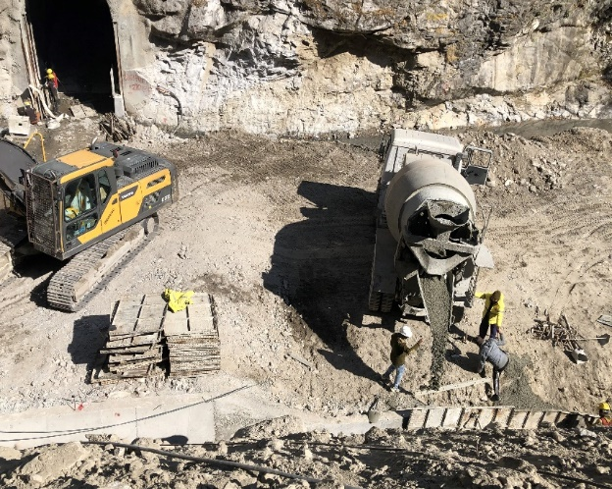
Kathmandu University
School of Engineering
Department of Civil Engineering
Likhu 1 Hydroelectric Project (77 MW)
Group: 14 Group Members: Sulav Lohani (31), Ramkrishna Mahato (33), Anish Pokharel (41), Prakash Sharma (61) Batch: Civil 2018 Site Supervisior: Er. Bhola Kumar Sahani Intern Coordinator: Asst. Prof. Santosh Chaudhary Internal Intern Supervisor: Er. Raju Bhele
Introduction
Tasks Performed
Likhu Khola 1 Hydroelectric Project is a Run-of-River (RoR) type project
Located in Likhu River at Solukhumbu District of Sagarmatha Zone and Ramechhap District of Janakpur Zone, Eastern Development Region, Nepal.
The project area is located within the latitude of 27º 40' 35" N and 27º 36' 00" N and Longitude of 86º 26' 00"E and 86º 28' 00" E.
The project uses the water from Nupche Khola, Bikhe Khola and Likhu Khola.
Project Cost (in NRs) is 8272.83 Millions
Observation of explosive charging for Undercut blast at Headrace tunnel (HRT)
Reinforcement and Concreting at Crown of Surge Shaft/ Ventillation tunnel
Installation of I-beam & Purlin in roof of Powerhouse
v. Inspection of Outlet adit portal & Penstock Trifurcation
Salient Features
Design Discharge | 17.5 m³/s
Gross Head | 534.25 m
Net Head | 517 m
Rated Capacity | 77 MW
Catchment Area | 253 km²
Mean Annual Flow | 16.87 m³/s
Highest Flood Level (HFL) | EL. 2265.50 m amsl
Length of trench weir ( Nupche head work) | 30.2 m
Width of trench weir ( Nupche Head work ) | 16.5 m
No. of intake gates & stop logs | 4 no.s
Size of intake gates & stop logs (BxH, m) | 3.3 x 2.5
Settling basin type | Hopper Type
Transation length of Settling Basin | 16 m
Collection Chamber size (LxBxH,m) | 14.5x26.5x9.75
Headrace tunnel shape, Diameter, Total length | D-shaped, 4.2 m, 7726.32m
No. of Adit Tunnel | 3 no.s
Surge shaft, Diameter | Restricted orifice type, 3.6 m
Valve Chamber, Diameter | Underground, Butterfly valve, 2.5 m
Pressure Shaft, Diameter | Underground, 2.2 m, circular
Powerhouse, No. of Units | Surface, Vertical Pelton Turbine, 3
Switchyard, Size (LxW, m) | Outdoor, 65x 60
Fig.4. Loading of explosive
Fig.5. Explosives
Fig.6. Formwork installation in crown
Fig.7. Reinforcement work in crown
Study Area & Catchment Area
Fig.8. I-Beam in roof of Powerhouse
Fig.9. Z-Shaped Purlin
Objectives
To be familiar with site work and inspection.
To be acquainted of engineering standards, principles and moral behavoir
Fig.10. Oulet Portal of HRT
Fig.11. Trifurcation of Penstock pipe
Tasks Performed
Analysis
During our six weeks internship period, we performed both office work as well as field work at Likhu 1 Hydroelectric Project. The task performed are listed below:
Office Work:
Report and Presentation of Likhu 1 HEP along with AUTOCAD drawings were studied which was provided by MV Dugar Group. We also learnt basic about Quantity survey and BBS of steel.
Field Work:
Inspection of Reinforcement work & Concreting at Nupche trench weir
Coherent relationship between Consultant, Client & Contractor for seamless flow of work at job site.
Achieved practical knowledge of the complete cycle of Drill and Blast method and equipment used in it.
Gained knowledege about equipments, plants, technologies & skilled manpower required for infrastructure construction.
Ability to think through and solve any problems encountered during construction in site.
Developed managerial and engineering skills required in site as an engineer.
Conclusion
Our internship at Likhu HEP has been a valuable and enlightening experience. During our tenure, we had the opportunity to gain experience in various aspects of civil engineering, including design, construction, project management and deep understanding of the technical and practical aspects of civil engineering applied in the real world. We are grateful for the guidance and mentorship provided by our HOD, Coordinator and supervisors, who have helped us to develop our skills and knowledge in civil engineering. We have also learned the importance of teamwork, communication, and attention to detail, which are essential for success in this field.
Fig.1. Reinforcement work in Cut-off wall
Fig.2. Concreting of Wing wall

Slide 2
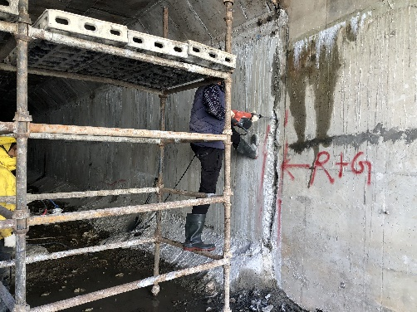
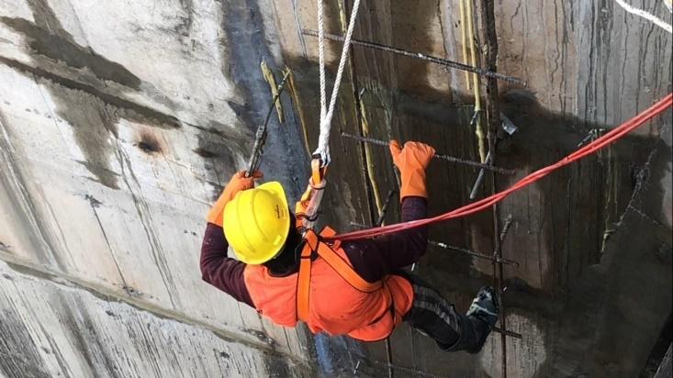
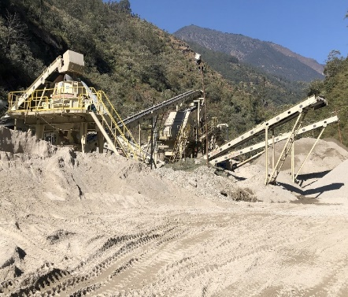
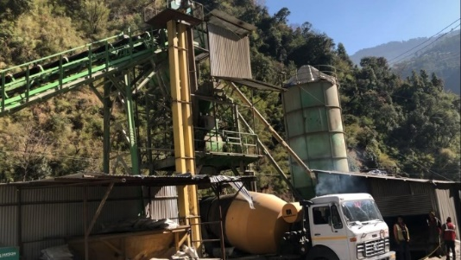
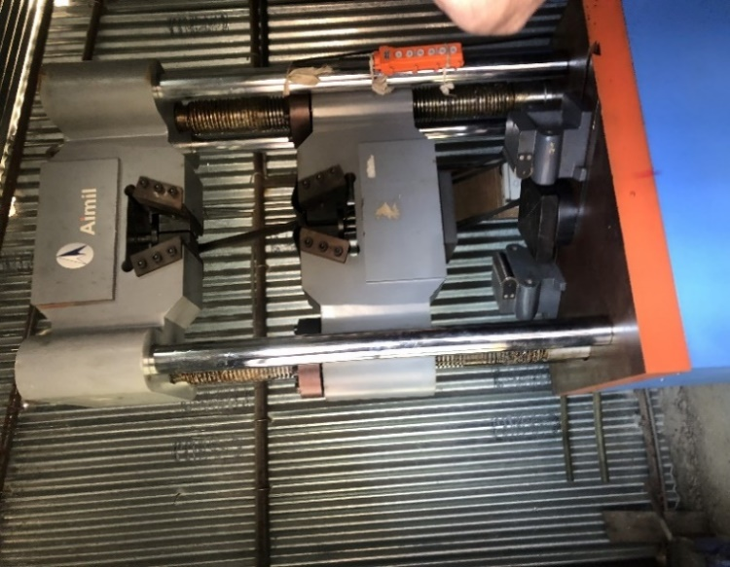
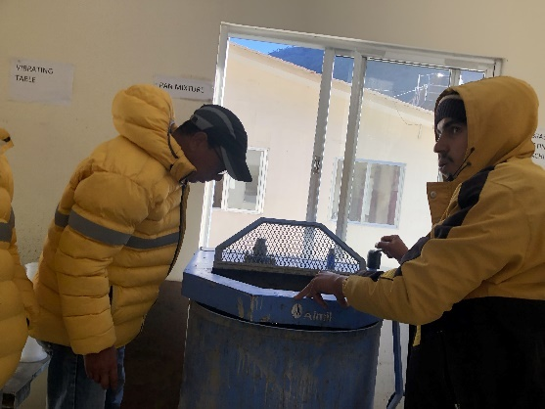

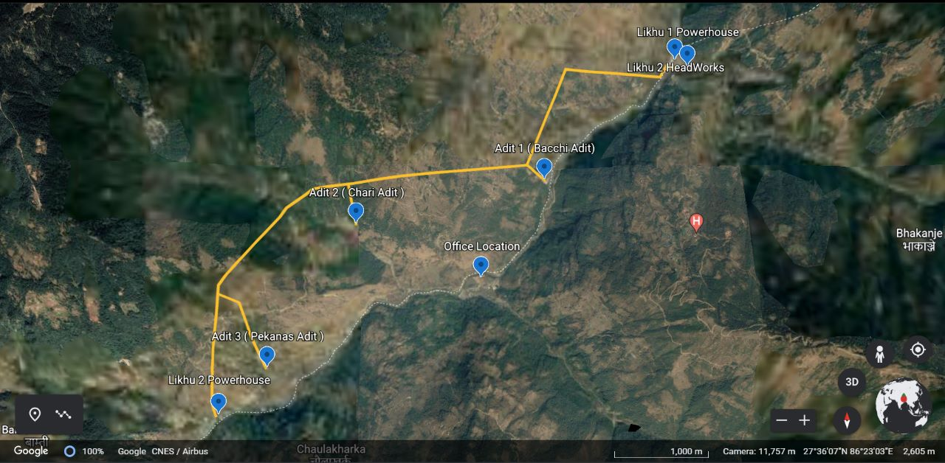
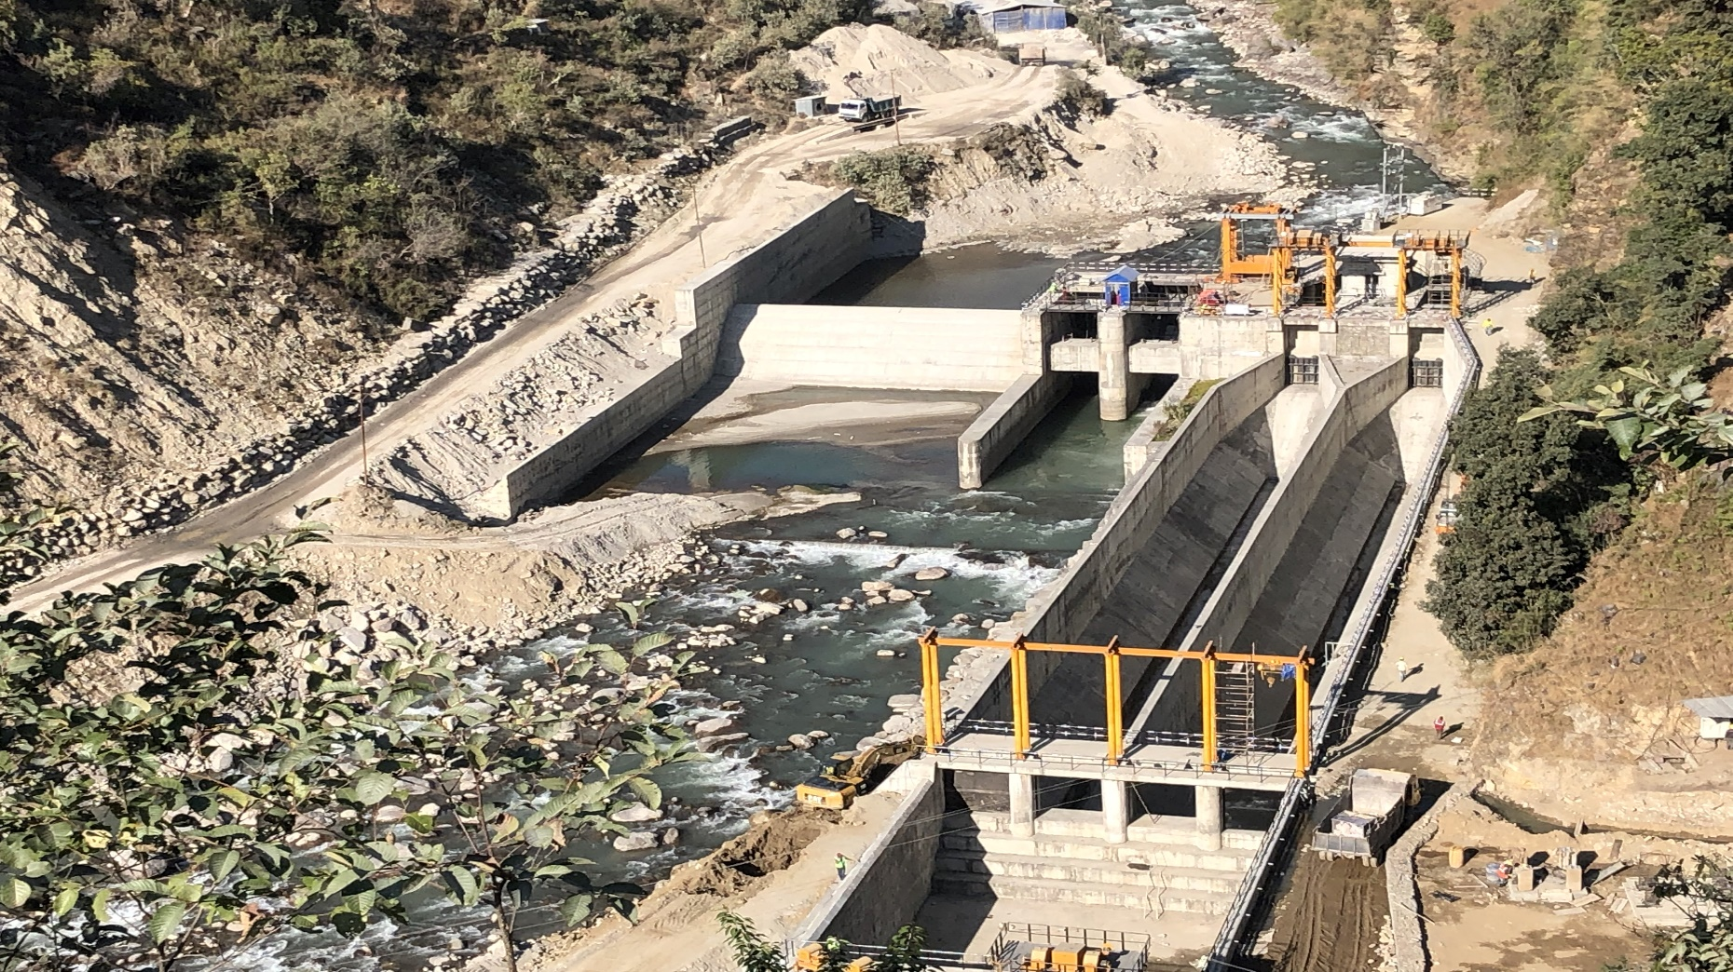
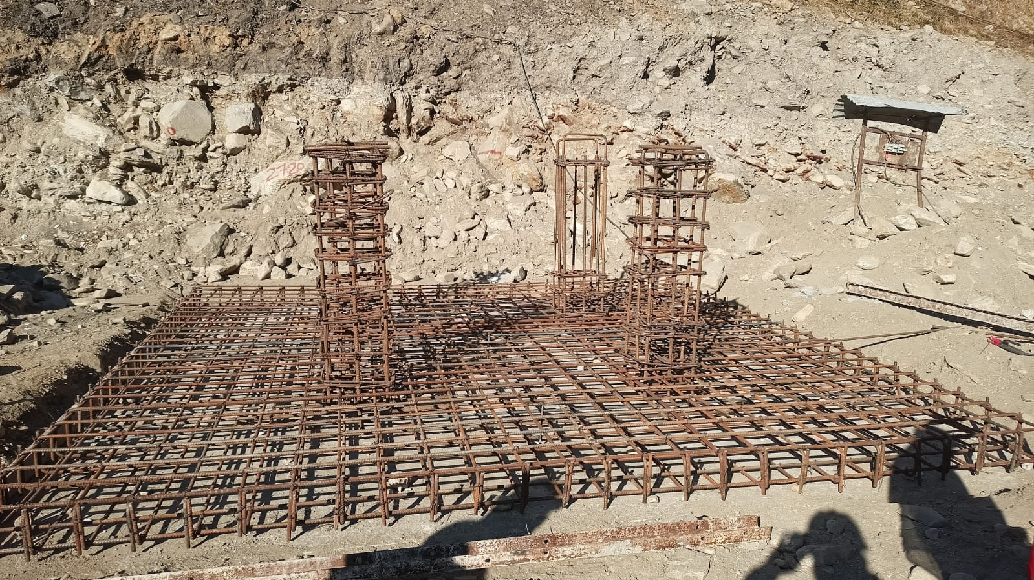
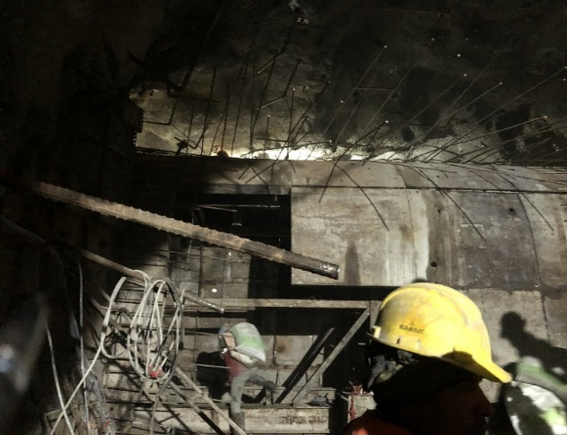
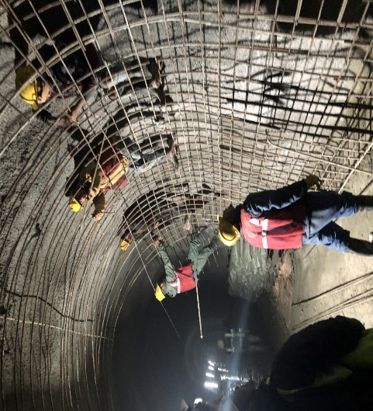
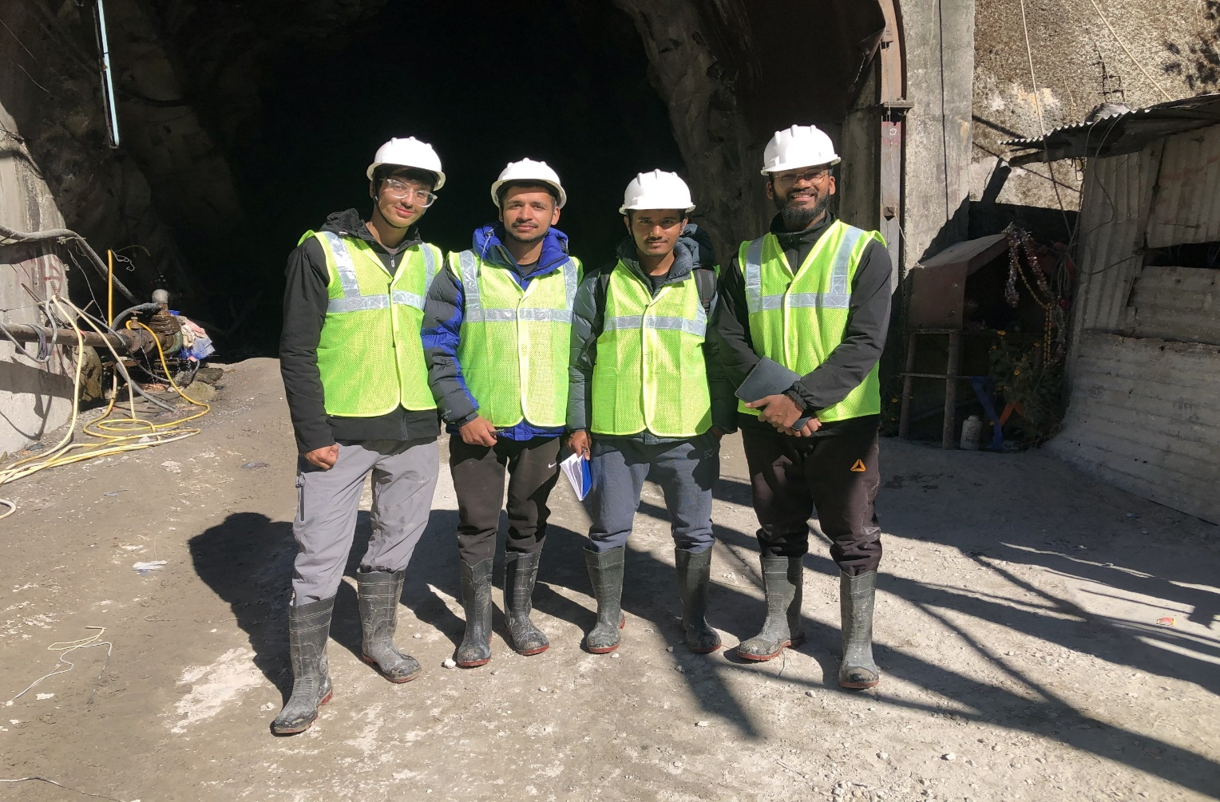
Kathmandu University
School of Engineering
Department of Civil Engineering
Likhu 2 Hydroelectric Project (55 MW)
Group: 14 Group Members: Sulav Lohani (31), Ramkrishna Mahato (33), Anish Pokharel (41), Prakash Sharma (61) Batch: Civil 2018
Site-Supervisior : Er. Bhola Kumar Sahani Intern Coordinator: Asst. Prof. Santosh Chaudhary Internal Intern Supervisor: Er. Raju Bhele
Introduction
Tasks Performed
Likhu Khola 2 Hydroelectric Project is a Run-of-River (RoR) type project
The project is located in Gumdel and Bhakanje VDCs of Ramechhap district and Solukhumbu district.
The project area is located within the latitude of 27º 34' 03" N and 27º 36' 26" N and Longitude of 86º 22' 43" E and 86º 26' 00" E.
The project uses the water from Likhu-1 trailrace discharge, Marbu Khola, Chari Khola & Likhu Khola.
Project Cost (in NRs) is 5375.75 Millions
Obsevation of Seepage control work at Tailrace channel and Collection pool
Visit to Crushing and Batching plant
Lab Tests were performed and results were analysed.
v. Observation of the headworks component and Reinforcement at Switchyard
Salient Features
Design Discharge | 26.4 m³/s
Design Flood at diversion site (100 Years RP) | 479 m³/s
Gross Head | 229.53 m
Catchment Area | 346 km²
Width of diversion structure at Likhu Khola | 56.0 m
Highest Flood Level (HFL) | El. 1728.0 m amsl
Full Supply Level (FSL) | El. 1724.5 m amsl
Length & Width of trench weir (Marbu Khola) | 27.7 m & 20.0. m
No. of intake gates & stop logs | 4 no.s
Type, Size of intake gates & stop logs (BxH) | Side Intake, 3.2m x 3.25m
No. of sulice bays, Type & Height of gate | 2, Radial Gates, 6 m
Settling basin type, No. of basins | Hopper, 2 no.s
Settling basin dimension (LxBxH, m) | 63.5x18.5x12.75
Headrace tunnel shape, Diameter, Total length | D-Shaped, 3.6m /4.2 m, 6465 m
No. of Adit Tunnel | 3 no.s
Surge shaft, Total Length | Inclined & Vertical, 190.759 m
Valve Chamber, Diameter | Underground, Butterfly valve, 2.5 m
Pressure Shaft, Diameter, Total Length | Underground, 2.5 m circular, 514 m
Powerhouse, Turbine Type, No. of Units | Surface, Vertical Axis Francis, 3
Tail Race Channel, Length | RCC Box Culvert, 263 m
Fig.3. Seepage control work in Tailrace Channel
Fig.4. Seepage control work in Collection Pool
Fig.5. Crushing Plant
Fig.6. Batching Plant
Study Area & Catchment Area
Fig.7. Universal Testing Machine
Fig.8. Pan Type Concrete Mix
Objectives
To be familiar with site work and inspection.
To be acquainted of engineering standards, principles and moral behavior.
Fig.9. Headworks components of Likhu 2 HEP
Fig.10. Reinforcement in switchyard foundation
Tasks Performed
Analysis
During our six weeks internship period, we performed both office work as well as field work at Likhu 2 Hydroelectric Project. The task performed are listed below:
Office Work:
Report and Presentation of Likhu 2 HEP along with AutoCAD drawings were studied which was provided by MV Dugar Group. We also learnt basic about Quantity survey and BBS of steel.
Field Work:
Visit & Inspection of Gantry formation at Adit-2 & RCC work at D/S transition
Coherent relationship between consulatant, Client & Contractor for seamless flow of work at job site.
Achieved practical knowledge of the complete cycle of Drill and Blast method and equipment used in it.
Gained knowledege about equipments, plants, technologies & skilled manpower required for infrastructure construction.
Ability to think through and solve any problems encountered during construction in site.
Developed managerial and engineering skills required in site as an engineer.
Conclusion
Our internship at Likhu HEP has been a valuable and enlightening experience. During our tenure, we had the opportunity to gain experience in various aspects of civil engineering, including design, construction, project management and deep understanding of the technical and practical aspects of civil engineering applied in the real world. We are grateful for the guidance and mentorship provided by our HOD, Coordinator and supervisors, who have helped us to develop our skills and knowledge in civil engineering. We have also learned the importance of teamwork, communication, and attention to detail, which are essential for success in this field.
Fig.1. Gantry Installation
Fig.3. Visit to Chari Adit
Fig.2. Reinforcement work at d/s transition

